Slide 1



Vodaplex - 2011 Business Overview
Welcome…..
Mozone

Slide 2

Vodaplex - 2011 Business Overview

Slide 3

Who We Are?
Headquartered in Atlanta, GA
Management team with 17 years of quality,
professional marketing and contracting
services experiences in the telco, wireless
and software industries
We provide customer acquisition using different
go-to-market strategies
  B2B, Retail, Special Event, Referral, Relationship Marketing
Notes:
Now let’s talk about a revolutionary new device from CLEAR - the CLEAR Spot Personal Hotspot.
This amazing little device allows Wi-Fi enabled devices to access CLEAR’s WiMAX network, and has a four-hour rechargeable battery life (it can also run on AC power).
So for a one-time cost of $139, customers can connect their Wi-Fi devices at broadband speeds anywhere within a CLEAR coverage area!

Slide 4



What the Expert Are Saying Now
A record 2.82 million homes faced foreclosure in 2009, according to RealtyTrac, a web-based firm that tracks and markets foreclosed homes. It is anticipated that at least 3 million more homes will enter foreclosure in 2010. An extra $500-$1000 per month could prevent 80% from foreclosure .
www.wsws.org
By Tom Eley 16 January 2010
The average annual cost of a four-year, private college is $35,000, while cost for four-year public college comes in at just under $14,000.
www.huffingtonpost.com
08-25-10 04:49 PM
Wells Fargo has released a new survey on retirement. Surprise, surprise, most of us are royally screwed. CNN calculated it out and realized most have only $190 a month to live on in retirement.
•One-third are worried about a job loss in their household in the coming year.

Slide 5



What Do We Do?
We acquire customers for the world's leading brands
in home and business services; and we help those who are
ready, willing and able to make extra $500-$1000 per month,
per week, or per day.
Notes:
Now let’s talk about a revolutionary new device from CLEAR - the CLEAR Spot Personal Hotspot.
This amazing little device allows Wi-Fi enabled devices to access CLEAR’s WiMAX network, and has a four-hour rechargeable battery life (it can also run on AC power).
So for a one-time cost of $139, customers can connect their Wi-Fi devices at broadband speeds anywhere within a CLEAR coverage area!

Slide 6

Vision Statement
Our Vision
The future of 4G wireless & Satelite TV distribution
is Vodaplex
No other companies can match our capabilities and scale.
At Vodaplex we are fully focused on being the best at what we do.
As a result our vision can be clarified in one singular statement:
We will be the global leader in 4G wireless distribution and satellite sales, creating opportunity for generations
Notes:
Now let’s talk about a revolutionary new device from CLEAR - the CLEAR Spot Personal Hotspot.
This amazing little device allows Wi-Fi enabled devices to access CLEAR’s WiMAX network, and has a four-hour rechargeable battery life (it can also run on AC power).
So for a one-time cost of $139, customers can connect their Wi-Fi devices at broadband speeds anywhere within a CLEAR coverage area!

Slide 7


DirecTV Product Offering

Slide 8


Vodaplex
DirecTV Products
Notes:
8

Slide 9
Why Direct TV
DIRECTV offers the best overall television experience
_{True HD Signaling (1080P)}
Dolby Digital 5.1 Surround Sound
More Programming (Choose 210+ OR 285+ Channels)
Lower Cost (Compared to Your Existing Cable Bill!)
Remote Demonstration from Smart Phone/Laptop
_{Remote Access to Your HD DVR}
Remote Viewing of Content from any Internet
_{Most international Programming}
_{Most HD Content}
_{Most Sports Programming}
_{Most On Demand content}

Slide 10
DirecTV Revenue Streams
DIRECTV Consumer Sales
DIRECTV Commercial Sales
DIRECTV Multi-Dwelling Unit Sales

Slide 11
DirectTV Sprint (2011) Offers
Xtra
$65.99/mo
Premium
$114.99/mo
Save $31/month
Month 1-12
Total $370 savings
Save $76 Month 1-3
Save $31/mo Month 4-12
Total $470 Savings
$34.99
MONTH 1-12
$65.99
MONTH 13-24
$38.99
MONTH 1-3
$83.99
MONTH 4-12
$114.99
MONTH 13-24
Add $10 to Include MRV (whole home DVR) with Free HD for Life
1 Room of Viewing Included – $6 Per Month for Additional Rooms
Notes:
11

Slide 12

Sprint Product Offering

Slide 13
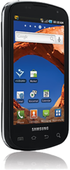
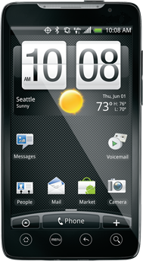
4G Wireless Evolution - 4G Demand: 30 Percent of Buyers in Next 12 Months –
by the Nielsen Company
A new survey of 2,100 U.S. adults by the
Nielsen Company suggests strong consumer
demand for "4G” devices over the next year,
despite some confusion about what that
actually means. More significantly, most
consumers seem able to correctly identify
the key differences between 4G and 3G,
the study suggests.

Slide 14


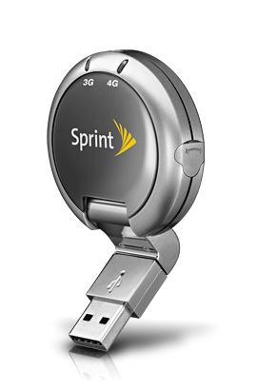
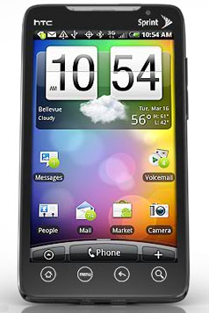
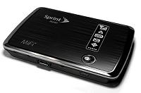
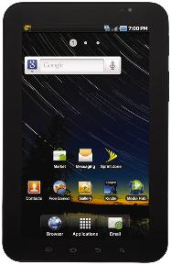
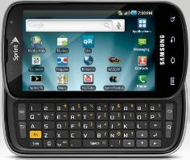
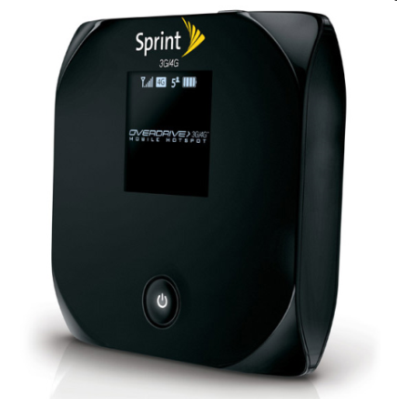
Sprint Product Offerings
3G sets records
4G breaks them…
What can you do with 4G?
Notes:
Partnership with Sprint enables Vodaplex resellers to profit from referring new customers. This includes the HTC Evo, the very first WiMAX enabled cell phone in the United States. National cell phone sales have topped over 13 million units each month for the last year. Do you think there might be an opportunity to refer people to the latest and greatest thing out there?

Slide 15

Sprint Product Pricing
EVO Phone ($299.99 - $100 MIR)
Various Plans
Add 4G ($10.00)
Add Hotspot ($29.99)
Everything Data 450 ($69.99)
Shared Plan Everything Data 1500 ($129.99)
EVO Shift 4G ($249.99 - $100 MIR)
Various Plans
Add 4G ($10.00)
Add Hotspot ($29.99)
Data Plan same as above
Sierra Overdrive 3G/4G $199.99
($49.99 after $100 Instant Rebate and $50 MIR)
$59.99 Unlimited 4G Data
Sierra USB 3G/4G $99.99
(FREE after $49.99 Instant Rebate and $50 MIR)
$59.99 Unlimited 4G Data
Samsung Galaxy Tablet $299.99
Plans (Currently 3G Only)
5GB data plan $59.99

Slide 16
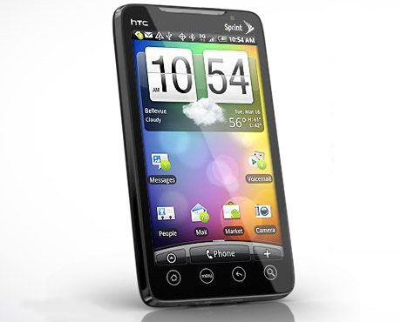
America’s 1st 4G Phone HTC EVO (Great Value)
3-10 Times faster speed in 4G coverage area
Unlimited 3G/4G Data Plan
4.3-inch Touch Screen
Two Cameras – Front and back for streaming video &
Video Conferencing
The Kickstand
Voice to Text/Email/Navigation
Real-Time Traffic Alert GPS
Mobile Hot Spot connects eight devices

Slide 17
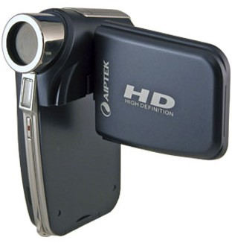
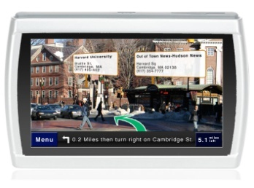


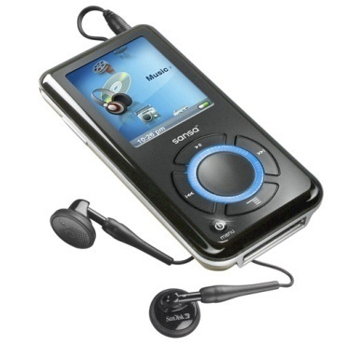

“Swiss-Army” Phone

Slide 18

Verizon Product Offering

Slide 19



Verizon Background
Phone
Broadband
HDTV
Global IP Network
Managed Services
Serving 98%
of Fortune 500
Largest U.S. Carrier
Broadest U.S.
Voice & Data Footprint
Unmatched Global Capabilities
2008 REVENUE US$97.1B

Slide 20

4G LTE Products
Pantech UML290
$99 after $100
MIR
$50/month 5GB
$80/month 10GB
$10/GB after
allowance
LG VL600
$99 after $100
MIR
$50/month 5GB
$80/month 10GB
$10/GB after
allowance
Fast Just Got Faster

Slide 21
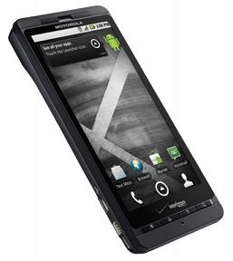
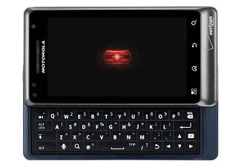
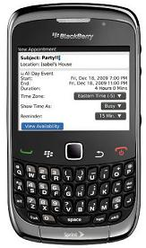
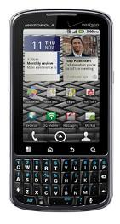
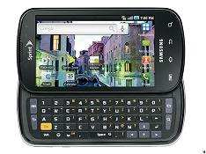
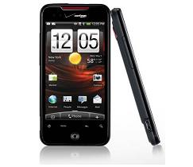
3G Smart Phones
Droid X by Motorola
Blackberry Curve 3G 9330
Droid 2 Global by Motorola
Droid
Incredible
by HTC
Droid Pro by Motorola
Samsung Fascinate
Fast Just Got Faster

Slide 22
New Products Coming Soon

Slide 23
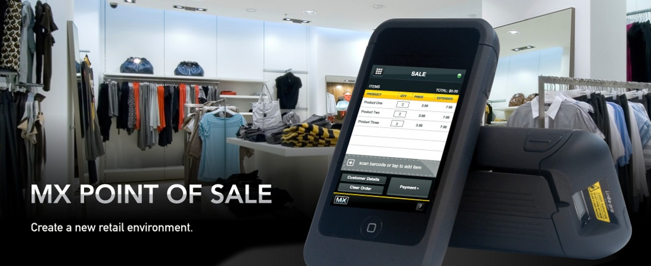
Voda POS – Merchant Account Systems

Slide 24
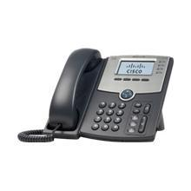
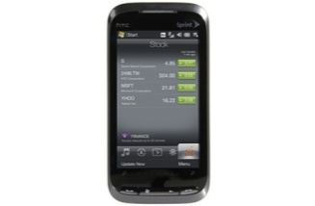
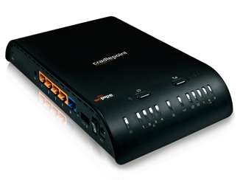
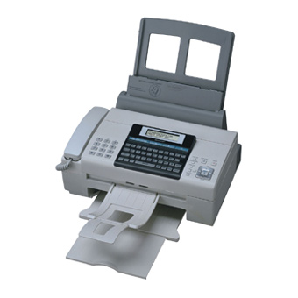
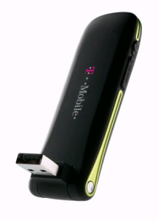
Small Business Wireless Solutions
All of the components of the Voda IP PBX components can run on 4G broadband.
  The Sprint/Verizon 3/4G USB stick for Internet access
  2. The CradlePoint router, which converts the 4G signal to WIFI and Internet Protocol (IP)
  3. The Cisco IP Phone, which is connected through Voda IP PBX, and which connects to all other VOIP and virtual (4G wireless) lines
  4. Virtual lines, which are multi-vendor smart phones that can be used to follow
Smart Phones 3G/4G Phones
Multi-vendors
Cisco IP Phone (Voda IP PBX)
Hotspot
Cradle Point Router
3/4G USB Sticks
IP VodaFax

Slide 25




Compensation Plan

Slide 26

DISCLAIMER
Success as an Vodaplex Independent Representative is not guaranteed, but rather influenced by an individual's specific efforts.
Not all Vodaplex Independent Representatives make a profit and no one can be guaranteed success as a Vodaplex Independent Representative.

Slide 27
Rank Advancement Plan
Account Executive = Authorized Reseller
Territory Manager = 12 Team Credits
Senior Territory Mgr = 30 Team Credits (45 Days, Fast Track)
or = 50 Team Credits (Standard Program)
National Director = 90 Team Credits (60 days, Fast Track)
or = 150 Team Credits (Standard Program)
Senior National Director = 3 ND Sales Teams

Slide 28
Compensation Plan (Get 1)
For Illustration Purpose (Avg $225):
Get 1: Sprint 4G Smartphone $200-$250
Direct TV Consumer $225-$250
Pays Over Rides .
Account Executive 38% = $ 85
+5% $12
Territory Manager 43% = $ 97 $35
+10% $23 $57
Sr Territory Mgr 53% = $120
+10% $22
National Director 63% = $142
+5% CAB
$11 Frontline

Slide 29
Compensation Plan (Get 2)
For Illustration Purpose (Avg $284)
2 x 4G Smartphone Shared Plan Pays $284-$424
1x 4G Smartphone + 1x Direct TV Pays $400-$500
Pays Over Rides .
Account Executive 38% = $108
+5% $14
Territory Manager 43% = $122 $42
+10% $28 $70
Sr Territory Mgr 53% = $150
+10% $28
National Director 63% = $178
+5% CAB
$14 Frontline

Slide 30
Compensation Plan (Get 3)
For Illustration Purpose (Avg $344):
Get 3: 3 x 4G Smartphone Pays $344-$624
Pays Over Rides .
Account Executive 38% = $130
+5% $18
Territory Manager 43% = $148 $52
+10% $34 $86
Sr Territory Mgr 53% = $182
+10% $34
National Director 63% = $216
+5% CAB
$17 Frontline

Slide 31
Compensation Plan ($$$Pick 3)
For Illustration Purpose (Avg $558):
$$$ Pick 3: 2x 4G Smartphone + 1x Direct TV Pays $558-775
Pays Over Rides .
Account Executive 38% = $212
+5% $28
Territory Manager 43% = $240 $84
+10% $56 $140
Sr Territory Mgr 53% = $296
+10% $56
National Director 63% = $352
+5% CAB
$28 Frontline

Slide 32
Income After Qualifying
as National Director
Notes:
“Any final questions before we end the training?”
Wrap the session by thanking the participants for their time and attention, and wishing them all the best of luck in their CLEAR careers.

Slide 33
ND Income (Get 1)
$30 Bonus Average on all Get 1 Sales in your ND Team
If you have 120 AEs, each AE goes making 1 Get 1 Sale
per week, or 4 per month:
120 x 4 = 480 Team Sales
480 x $30 = $14,400
Total ND Monthly Income = $14,400
You

Slide 34
ND Income (Get 2)
$40 Bonus Average on all Get 2 Sales in your ND Team
If you have 120 AEs, each AE goes making 1 Get 2 Sale
per week, or 4 per month:
120 x 4 = 480 Team Sales
480 x $40 = $19,200
Total ND Monthly Income = $19,200
You

Slide 35
ND Income (Get 3)
$50 Bonus Average on all Get 3 Sales in your ND Team
If you have 120 AEs, each AE goes making 1 Get 3 Sale
per week, or 4 per month:
120 x 4 = 480 Team Sales
480 x $50 = $24,000
Total ND Monthly Income = $24,000
You

Slide 36
ND Income ($$$Pick 3)
$100 Bonus Average on all $$$Pick 3 Sales in your ND Team
If you have 120 AEs, each AE goes making 1 $$$Pick 3
Sale per week, or 4 per month:
120 x 4 = 480 Team Sales
480 x $100 = $48,000
Total ND Monthly Income = $48,000
You

Slide 37
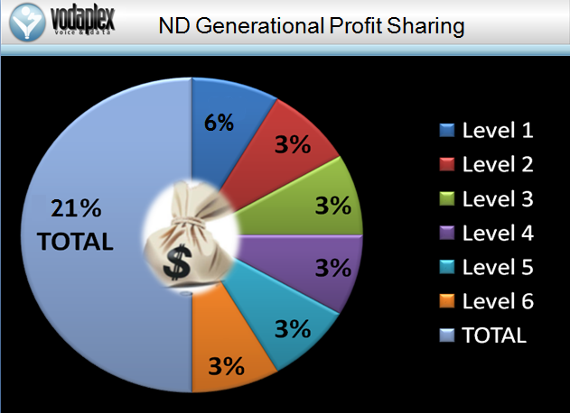
ND Generational Profit Sharing

Slide 38



4% SND Profit Sharing Pool
As a Senior National Director you will
participate in 4% of company-wide sales
each month based on your team production.
Notes:
“Any final questions before we end the training?”
Wrap the session by thanking the participants for their time and attention, and wishing them all the best of luck in their CLEAR careers.

Slide 39
How to Get Started
The qualification to own a Vodaplex business
Get 1 Qualifying Sale
2) No upfront startup cost, Get your own replicated website & back office for $19.99/month
(website, accounting, training, business tracking, support staff, etc.)
3) Scan and Email W9, IR and Direct Deposit forms
Notes:
39

